Slide 1




Slide 2
Actual Comments
“Intuitive”
“Mind-bending”
“Friendly”
“Tastes like a
cool purple”

Slide 3
Purpose
Inform the public about what synesthesia is and why it can be interesting.
Main tools
Procedural rhetoric
Conversation-like narrative

Slide 4

Technology
GameMaker

Slide 5

Assets
Art
100% original
GameMaker image editor
Dialogue
Also original
Sounds
100% public domain
freesound.org + filter

Slide 6
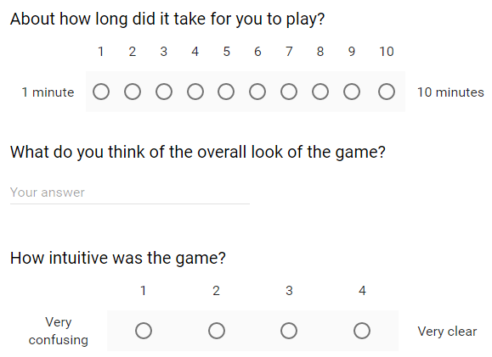
Survey

Slide 7
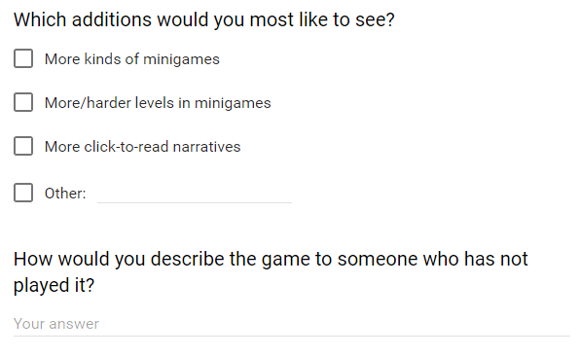
Survey

Slide 8
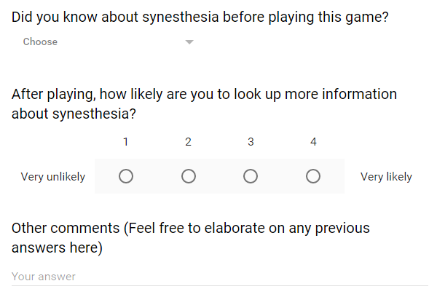
Survey

Slide 9
Impact of Survey
Slight decrease in difficulty: hint system
Extra type of synesthesia mentioned

Slide 10
Pluses and Minuses
+
–
Narration style resonated with audience
Magnet game produced “aha moments”
Almost all players got at least some educaional benefit
Difficulty level was not perfect
Magnets overshadow rest of game

Slide 11
Words of Wisdom
If you suspect even a little bit that your game idea might be scoped too large:
Before coding any new level or game mechanic, either
Devise a way to develop it rapidly, or
Scrap the idea.
Once you have a complete game, go back and add in scrapped ideas if time permits.

Slide 12
Thank you and have a
great Thursday!
sky blue

